Slide 1


Expense Tracker Web application
A full-stack Django Project for Managing personal expenses
Alejandro Jorge

Slide 2

Project Overview
Users can add and categorize their expenses easily.
View total spending and detailed breakdowns for better insights.
Visualize trends over time to track spending habits.
Sort graphs by daily, weekly, monthly, or yearly views.
The application is built using Django, Bootstrap, and Matplotlib for a robust experience.
Notes:
This slide provides an overview of the project's capabilities. Users have the ability to add and categorize expenses, gaining insights through visualizations of their spending habits. They can sort their data by various timeframes, which enhances their understanding of financial behavior. The technology stack used for building the application ensures a reliable and user-friendly experience.

Slide 3

Design and Technical Implementation
Responsive user interface created using HTML and Bootstrap.
Backend developed with Django, utilizing views, models, and forms.
SQLite serves as the default database for data storage.
Graphical representations generated with Matplotlib as base64 images.
Notes:
This slide delves into the technical aspects of the application design. The frontend leverages HTML and Bootstrap to ensure a responsive layout. The backend is powered by Django, which handles the data logic through its views, models, and forms. SQLite is chosen as the default database for simplicity, and Matplotlib is utilized for generating dynamic charts in a base64 format.

Slide 4

Key Folders and Files Breakdown
Key Components of TrackerApp
models.py defines Expense and Category models
views.py manages application logic
forms.py creates dynamic user submission forms
urls.py directs users to appropriate views
templates/trackerapp/ directory holds all HTML templates
management/commands/seed.py: Custom command to generate test data
requirements.txt: Dependencies
db.sqlite3: Default database
Notes:
This slide explores the important folders and files in the trackerapp. Each file plays a crucial role in the overall functionality of the application. For instance, 'models.py' is essential for defining data structures, while 'views.py' connects user actions to application responses. Understanding these components is vital for maintaining and enhancing the application.

Slide 5
Step-by-Step Guide to Running the Application
Clone or unzip the project files
Set up vrttual Environment
python3 -m venv venv
Activate Virtual Environment
source venv/bin/activate
Install Required Packages
pip install django matplotlib
pip install pillow
Apply Migrations
Run the development server
Visit
Seed the DB with Sample Data
python3 manage.py makemigrations
python3 manage.py migrate
python3 manage.py runserver
python3 manage.py seed
http://127.0.0.1:8000/
Notes:
This slide provides a clear step-by-step guide for users to run the expense tracker application. First, ensure that the project is properly cloned or unzipped. Then, create a virtual environment and install the necessary dependencies. Running migrations is crucial for database setup, followed by starting the server for user access. Finally, the application can be accessed via the provided localhost URL.

Slide 6
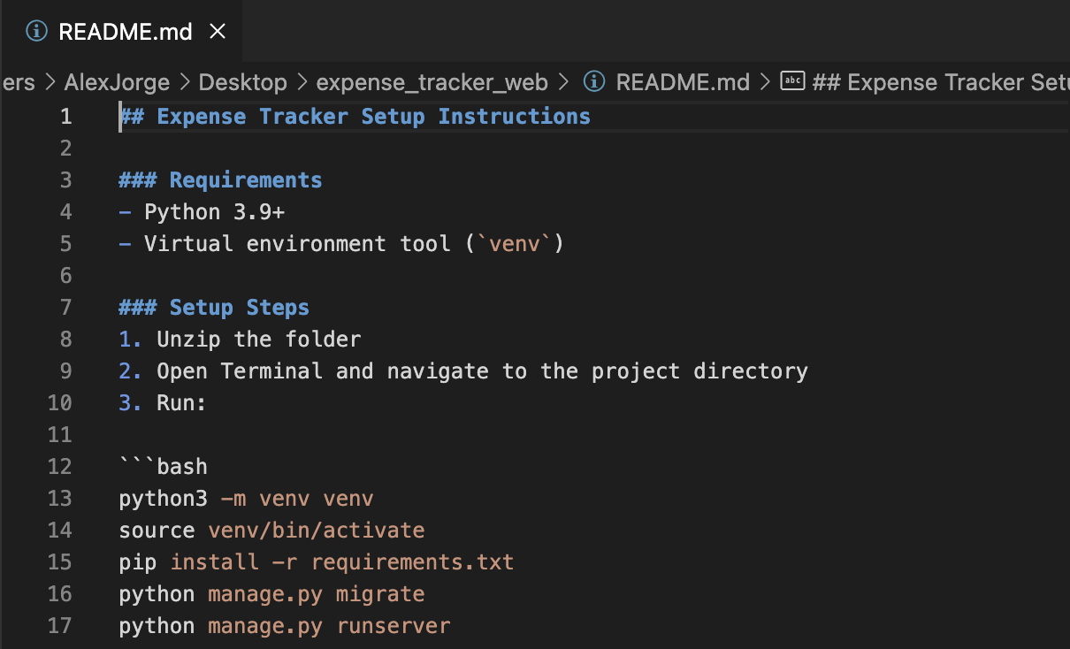
README.md

Slide 7
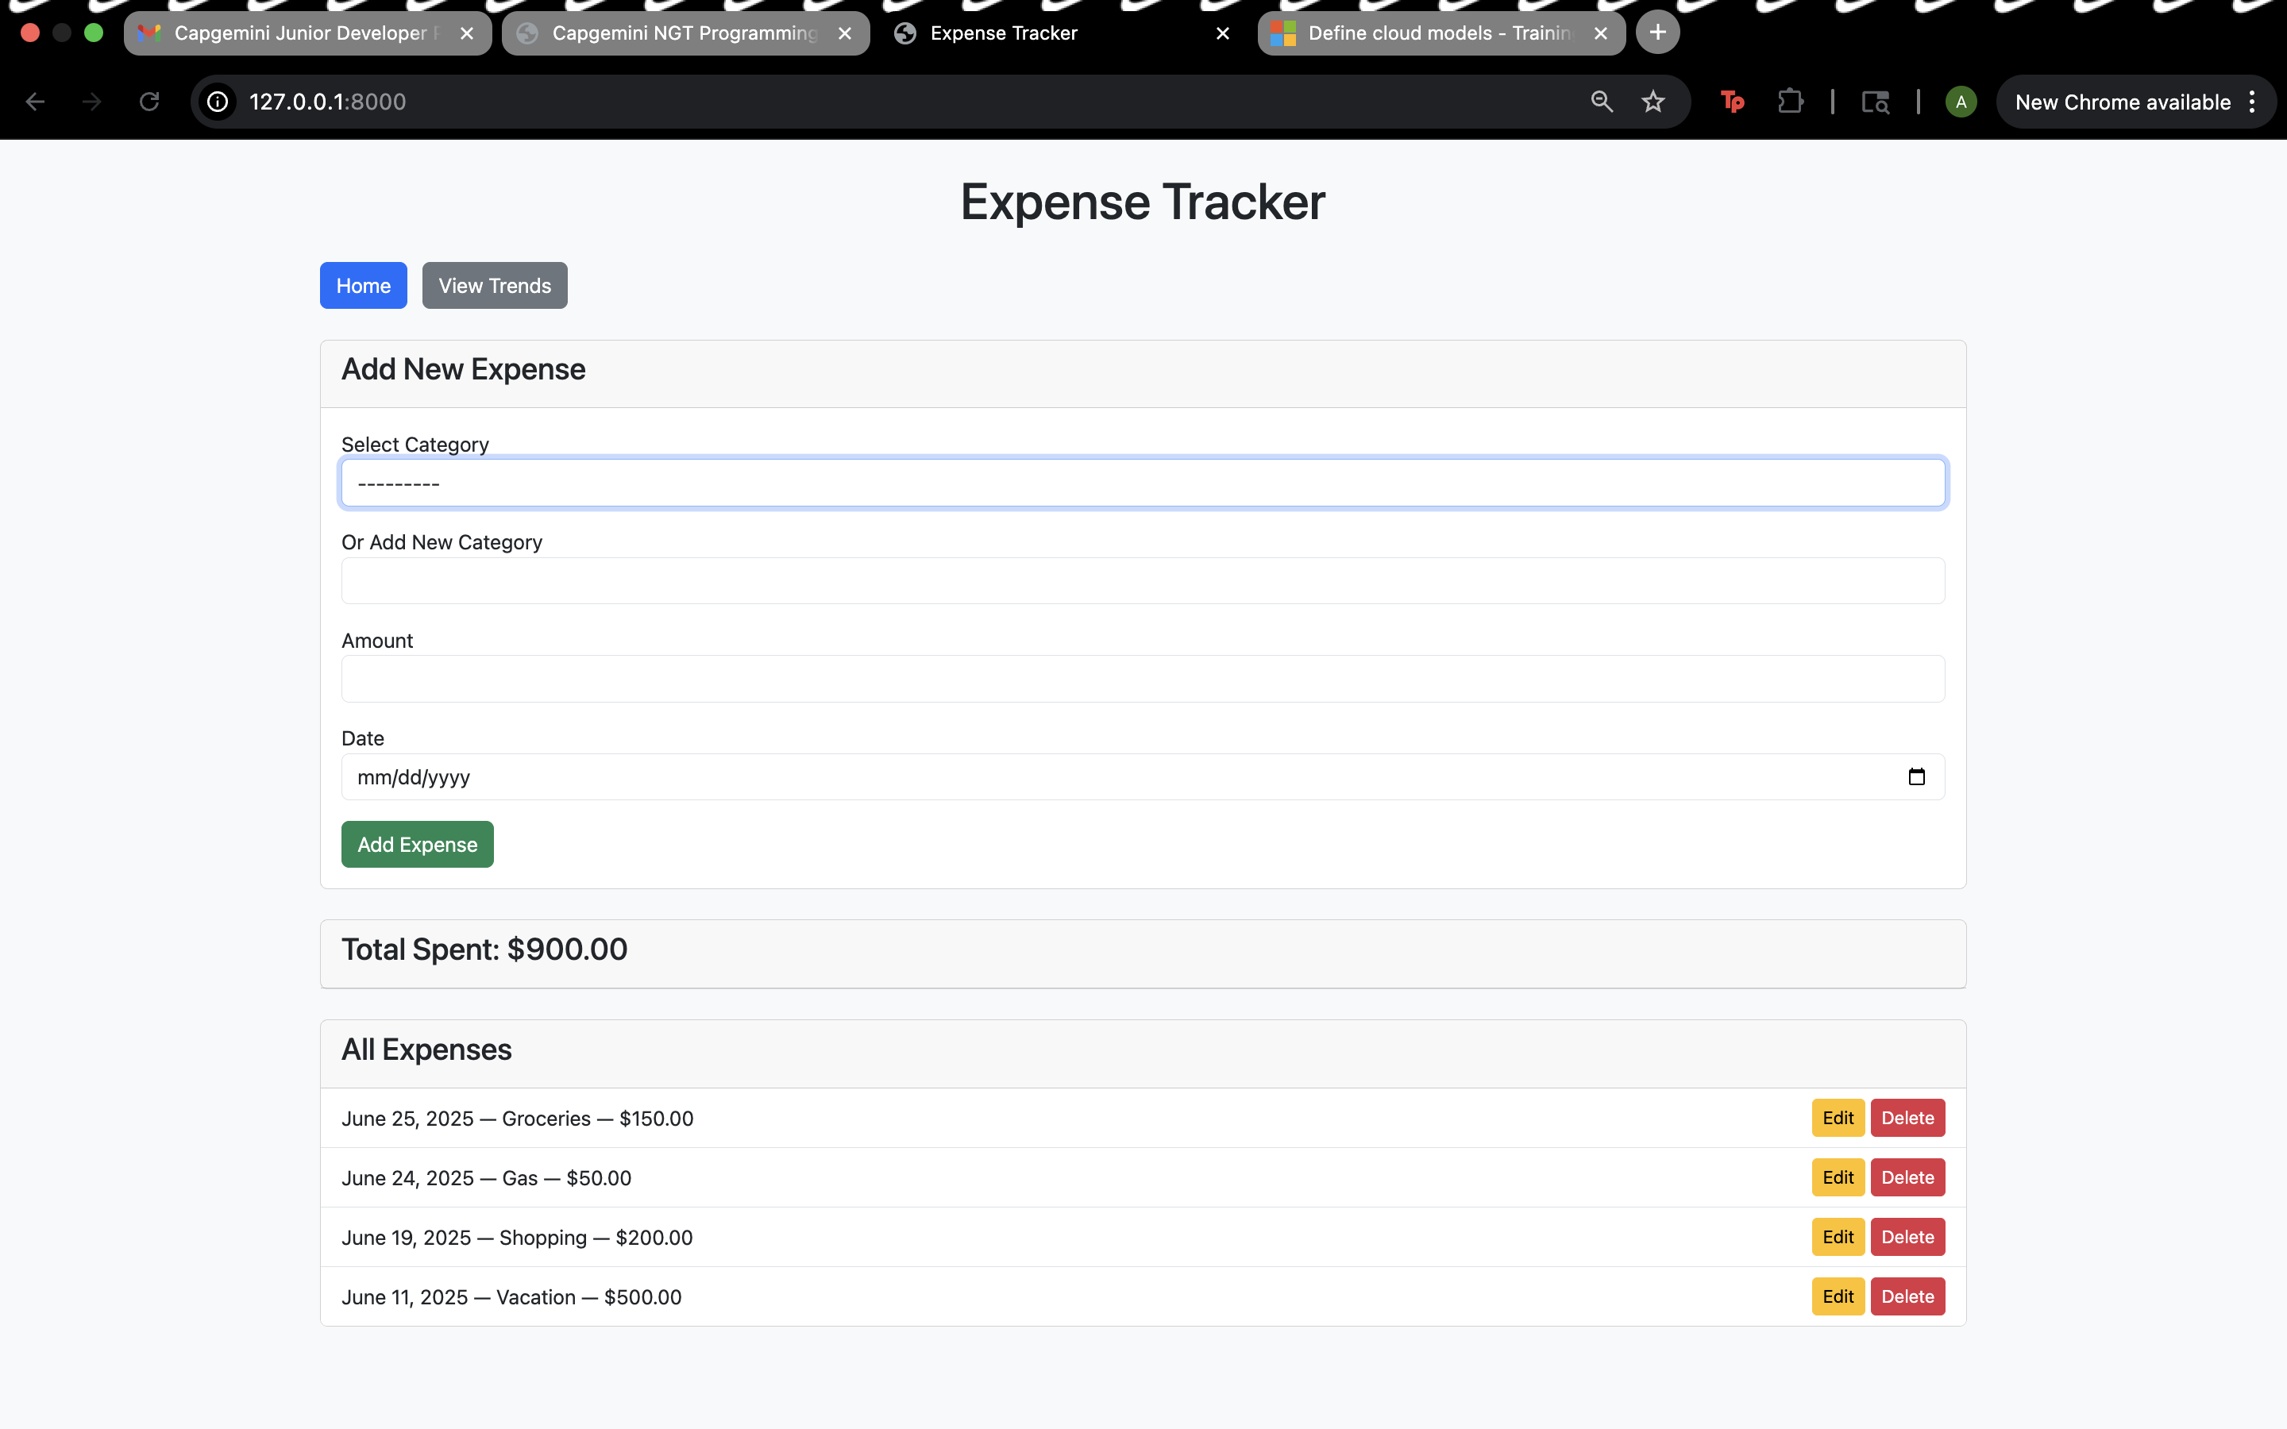
Testing & Verifying Your Application
Add sample expenses through the user form.
Verify that entries show up under 'All Expenses'.
Ensure charts update correctly in 'View Trends'.
Check if categories can be created dynamically.
Confirm that edit and delete functions operate smoothly.
Notes:
In this slide, we focus on the testing and verification process of our expense tracker application. Start by adding sample expenses to ensure functionality. Next, verify that these entries are visible in the 'All Expenses' section. It's also crucial to check that the visual data representations update in 'View Trends'. Finally, test the dynamic creation of categories and the effectiveness of editing or deleting entries.

Slide 8

Testing and Verifying Your Application
Use python3 manage.py seed to:
Auto-create test categories (e.g., Food, Health)
Generate 30 days of sample expenses
Open app in browser and:
Add new expenses manually
Test new category creation
Navigate to “View Trends” for graph verification
Verify:
Total and category spend match
Charts load correctly
Edit/delete functionality works
Notes:
This slide focuses on the practical steps to test and verify your application. By using the command 'python3 manage.py seed', you can auto-create categories and sample expenses, facilitating immediate manual testing. You should also verify that the app behaves correctly, with charts loading properly, and that you can edit or delete entries without issues.

Slide 9

Enhanced User Experience Features
Integrate a dynamic dropdown for category selection.
Allow users to create new categories seamlessly.
Implement edit and delete buttons for each entry.
Incorporate chart filters for various time frames.
Use HTML5 date picker for easier date input.
Notes:
This slide highlights additional features that improve user experience. A dynamic category dropdown enables quick selection, while the option to create new categories enhances flexibility. Edit and delete buttons for each entry streamline management, and chart filters allow users to analyze data over different periods. Finally, the HTML5 date picker simplifies date entry for users.

